Slide 1

Data Storytelling with Tableau Business Intelligence: Part 1 Intro
Notes:
Prompt: Data Scientists telling stories about artificial intelligence to a group of children, realistic

Slide 2
Learning Objectives
By the end of this lesson, students will be able to:
Explain the purpose and value of Business Intelligence (BI) in modern organizations.
Identify key BI tools and compare their strengths and limitations.
Use Tableau to connect to data sources, create visualizations, and design dashboards.
Interpret data visualizations to support business decision-making.
Present insights derived from Tableau dashboards.

Slide 3

What is Business Intelligence
Business Intelligence (BI) refers to the processes, technologies, and tools that organizations use to collect, integrate, analyze, and present business data in order to make informed, data-driven decisions.

Slide 4
Components of a Business Intelligence Platform
Data Sources – Systems where raw data originates (e.g., sales databases, ERP systems, cloud apps).
Data Integration (ETL) – Extracting, transforming, and loading data into a centralized location like a data warehouse.
Data Storage – Repositories such as data warehouses or data lakes that store structured and unstructured data.
Analytics & Reporting Tools – Tools like Tableau, Power BI, and Qlik Sense used to visualize data and create dashboards.
Decision-Making – Business leaders interpret dashboards and reports to guide actions and strategy.

Slide 5
Comparison of Business Intelligence Tools
BI Tool | Vendor | Deployment | Key Strengths | Limitations | Best Use Case
Tableau | Salesforce | Cloud / Desktop | Powerful visualizations, intuitive drag-and-drop interface, strong community | Higher licensing costs, can be complex for beginners | Data visualization and storytelling for medium-to-large enterprises
Power BI | Microsoft | Cloud / Desktop | Seamless Microsoft integration, cost-effective, easy DAX language | Limited non-Microsoft integrations, can slow down with large data sets | Corporate reporting within Microsoft ecosystem
Qlik Sense | Qlik | Cloud / On-Prem | Associative data model, strong self-service discovery, in-memory analytics | Steeper learning curve, less intuitive UI | Ad-hoc analysis and data discovery for technical users
Looker | Google | Cloud | Embedded analytics, flexible data modeling via LookML, modern web-based design | Requires knowledge of LookML, limited offline functionality | Embedding BI in SaaS platforms or web apps
QuickSight | AWS | Cloud | Serverless, scalable, integrated with AWS ecosystem, low maintenance | Limited advanced analytics and visualization options | Cloud-native analytics for AWS-centric organizations

Slide 6
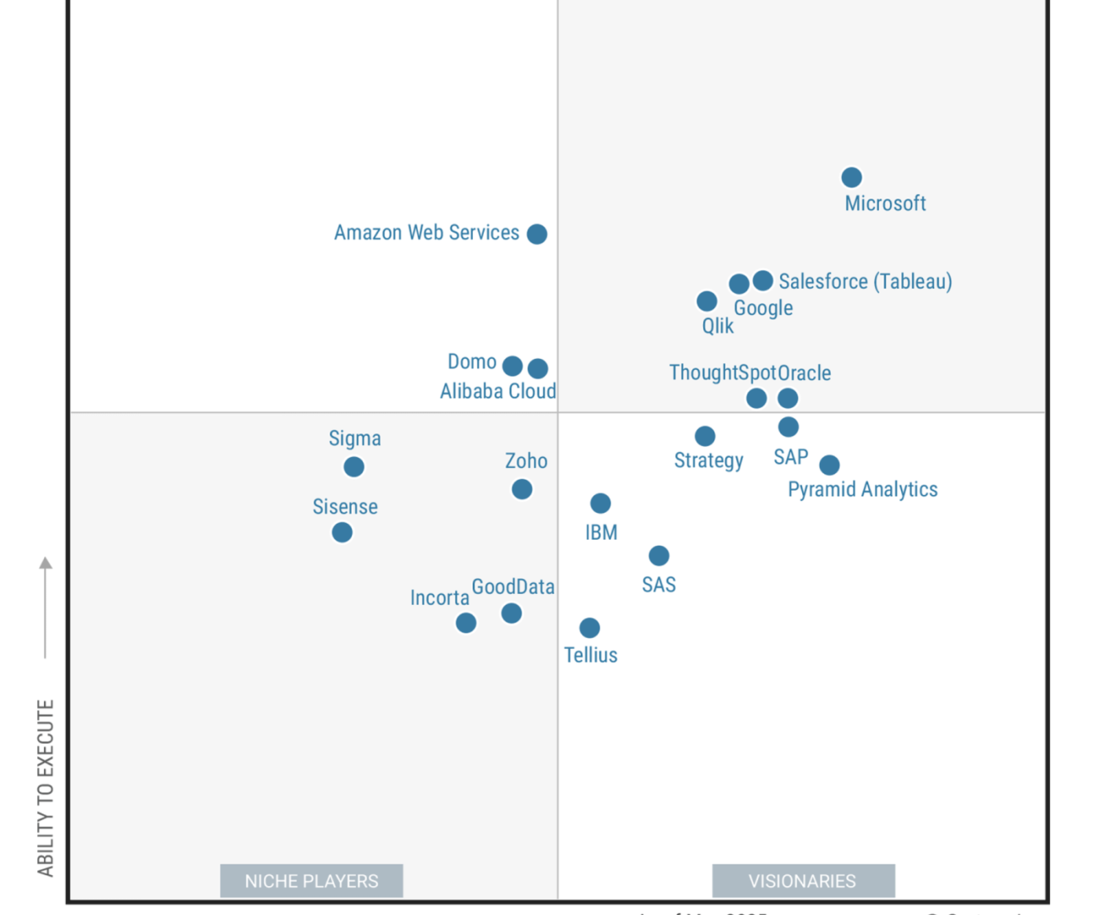
Gartner Magic Quadrant for Business Intelligence 2025

Slide 7

What is Data Storytelling?
Data storytelling is the process of translating data analysis into an easily understandable narrative. It combines three key elements:
Data: The raw facts, figures, and insights derived from your BI tools.
Narrative: The plot, characters, and context that give meaning to the data.
Visuals: Charts, graphs, dashboards, and other graphical representations that make the data accessible and engaging.

Slide 8
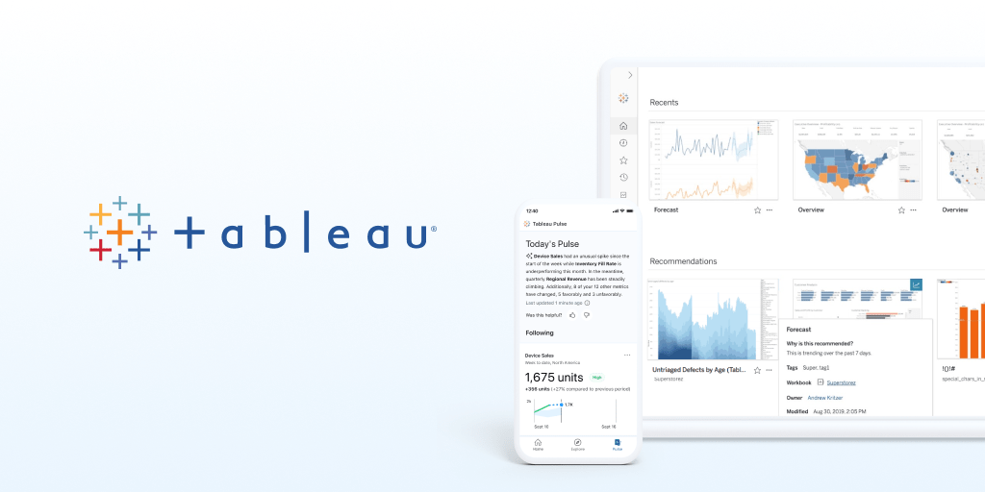

Slide 9
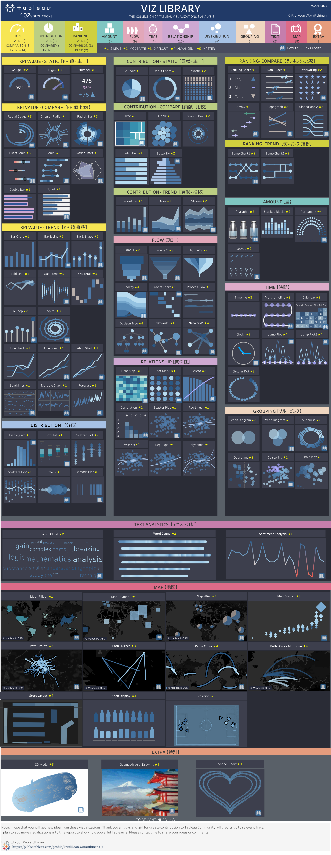

Slide 10
Tableau Demo

Slide 11
Key Takeaways
BI tools empower data-driven decision-making.
Tableau enables fast and interactive visual analysis.
Visualization is not the end — interpretation and communication of insights are critical.
BI complements AI by making model outputs understandable to business users.

